Slide 1
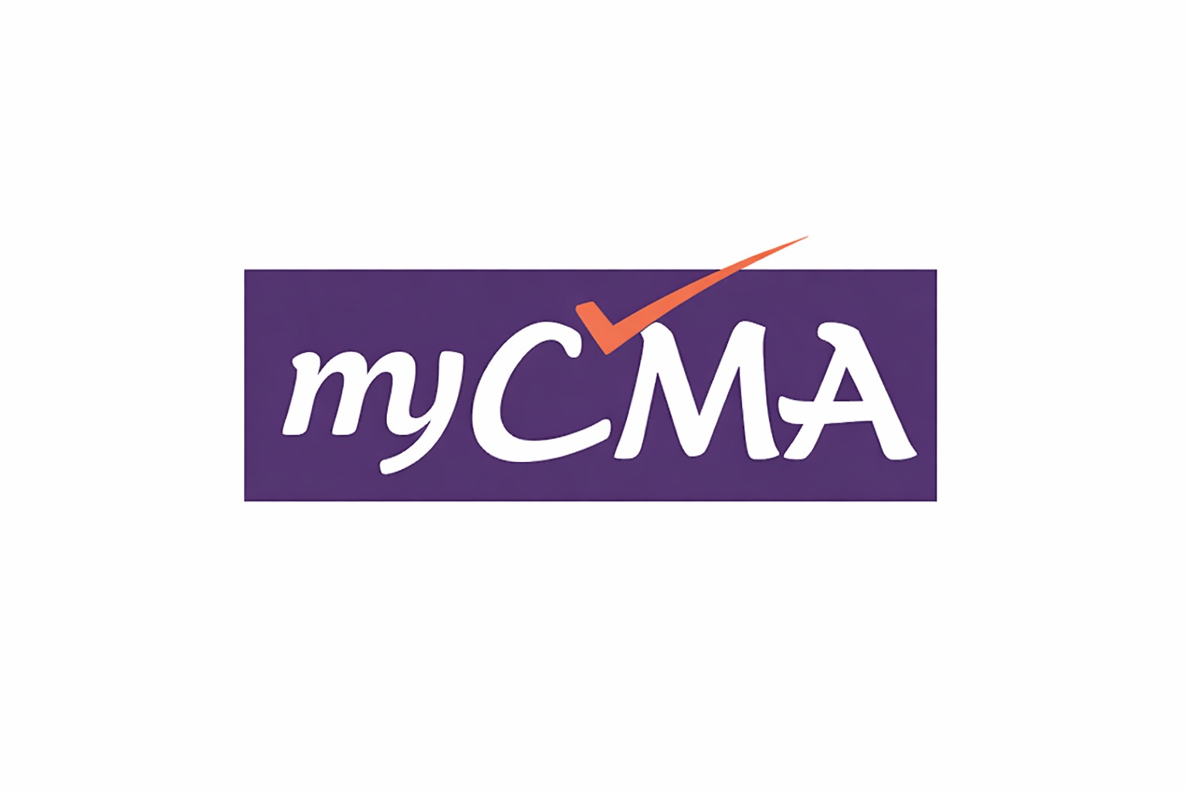
Business Communication
CMA Foundation | Paper 1 – Fundamentals of Business Laws and Business Communication
Lecture PPT • Exam Oriented • MCQ Practice
Prepared by myCMA | www.mycma.in

Slide 2
Learning Objectives
1
Understand the core concepts and features of effective Business Communication
2
Identify and distinguish between different types and flows of communication
3
Apply concepts of business writing – letters, memos, reports, and proposals
4
Recognise barriers to communication and strategies to overcome them
5
Attempt exam-style MCQs on intercultural, legal, and internet-based communication
Business Communication | CMA Foundation – Paper 1

Slide 3
5.1 Introduction to Business Communication
Communication = Sharing of information, ideas, or feelings between two or more parties to achieve a desired outcome
Sender
Encoding
Channel
Decoding
Receiver
▶
▶
▶
▶
◄ Feedback ◄
The word 'communication' is derived from the Latin word 'communis' meaning 'to share'
Business Communication is goal-oriented, structured, and formal in nature
It involves internal communication (within org) and external communication (outside org)
Noise is any disturbance or barrier that interrupts the smooth flow of communication
Business Communication | CMA Foundation – Paper 1

Slide 4
5.2 Features of Effective Business Communication – The 7 C's
Clarity
Courtesy
Message must be clear and easy to understand. Avoid ambiguity.
Respectful and polite tone. Consider receiver's feelings.
Conciseness
Concreteness
Short and to the point. Avoid unnecessary words.
Specific and definite facts and figures. Not vague.
Completeness
Coherence
All required information must be included. No gaps.
Logical, connected, and consistent flow of ideas.
Correctness
Proper grammar, facts, and syntax. Error-free message.
Note: Some texts add an 8th 'C' — Considerateness (audience-focused writing)
Business Communication | CMA Foundation – Paper 1

Slide 5
5.3 Process of Communication
1
Development of an Idea
2
Encoding
Sender thinks of an idea or information to be communicated — the first step.
Sender converts the idea into symbols: words, images, gestures, etc.
3
Selection of Channel
4
Transmission
Appropriate medium chosen: oral, written, electronic, non-verbal.
Message sent through the selected channel to the receiver.
5
Decoding
6
Feedback
Receiver interprets and understands the message.
Receiver responds — confirms whether message was understood correctly.
Business Communication | CMA Foundation – Paper 1

Slide 6
5.4.1 Formal and Informal Communication
Formal Communication
Informal Communication (Grapevine)
Follows official channels and hierarchy
Flows freely without official channels
Documented and recorded for future reference
Not documented; based on social interaction
Used in official reports, letters, circulars, notices
Also called 'Grapevine' — fast but often inaccurate
Advantages: Reliable, authoritative, maintains discipline
Types: Single Strand, Gossip Chain, Probability Chain, Cluster Chain
Disadvantages: Slow, rigid, lacks personal touch
Advantages: Fast, builds social bonds; Disadvantage: May spread rumours
Business Communication | CMA Foundation – Paper 1

Slide 7
5.4.2 Verbal, Non-Verbal and Written Communication
Verbal Communication
Non-Verbal Communication
Written Communication
Face-to-face, phone, meetings, speeches, debates
Facial expressions, gestures, eye contact, posture
Letters, emails, memos, reports, notices
Immediate feedback possible
Chronemics: use of time | Artifacts: use of objects/appearance
Provides legal evidence and permanent record
Kinesics: body language | Paralanguage: tone/pitch/speed
Accounts for ~55% of total communication impact
Allows careful thought and revision before sending
Proxemics: use of space | Haptics: use of touch
Can reinforce or contradict verbal messages
Impersonal in nature; no immediate feedback
Business Communication | CMA Foundation – Paper 1

Slide 8
5.4.3 – 5.4.5 Communication Flows in an Organisation
Downward
Upward
Superior → Subordinate. Instructions, orders, policies. e.g., Boss to staff.
Subordinate → Superior. Feedback, reports, grievances. e.g., Employee to manager.
Horizontal / Lateral
Diagonal
Between employees at the same level. Coordination and cooperation. e.g., Manager to Manager.
Across departments and levels. e.g., Accounts manager communicating directly with IT staff.
Vertical
Grapevine (Informal)
Combines both upward and downward. Flows along organizational hierarchy.
Unofficial, unstructured flow. Fast but unreliable. Can be single strand, gossip, cluster, or probability chain.
Business Communication | CMA Foundation – Paper 1

Slide 9
5.5 Internet Based Business Communication
The internet has transformed business communication through speed, reach, and cost-efficiency
Email
Video Conferencing
Formal, documented, global reach. Most widely used business communication tool.
Real-time face-to-face virtual meetings. e.g., Zoom, MS Teams, Google Meet.
Instant Messaging / Chat
Social Media
Quick real-time communication. e.g., Slack, WhatsApp Business.
LinkedIn, Twitter – used for marketing, branding, and professional networking.
FAQ / Help Portals
Cloud Collaboration
Providing Frequently Asked Questions (FAQ) to customers — improves support care.
Shared documents and workflows in real-time. e.g., Google Workspace, SharePoint.
Business Communication | CMA Foundation – Paper 1

Slide 10
5.6 Do's and Don'ts of Communication through Social Media
✔ Do's
✘ Don'ts
Maintain professionalism in all posts and messages
Do not post confidential or sensitive company information
Use appropriate language and tone — be courteous
Avoid abusive, offensive, or inappropriate language
Protect confidential business data at all times
Do not engage in personal disputes on official handles
Respond to queries and feedback promptly
Avoid excessive use of emojis — use them cautiously
Credit original sources and respect intellectual property
Do not share unverified or false information
Review and proofread before posting
Avoid mixing personal and professional content
Business Communication | CMA Foundation – Paper 1

Slide 11
5.7.1 Letter and Memorandum (Memo)
Business Letter
Memorandum (Memo)
Heading / Letterhead
Subject
Purpose:
Internal communication within the organisation
Date
Body
Format:
To: | From: | Date: | Subject: (No salutation)
Reference
Complimentary Close
Nature:
Concise, factual, formal internal document
Inside Address
Signature
Use:
Convey policies, decisions, reminders, announcements
Salutation
Office Order:
Special type of memo issued by authority; includes Order No., Subject, Date, Undersigned
Types: Quotation Letter | Order Letter | Complaint Letter | Goodwill Letter | Circular Letter | Recovery Letter
Note:
Memo does NOT include salutation or complimentary close
Business Communication | CMA Foundation – Paper 1

Slide 12
5.7.2 Report – Formal and Informal
A Report is a formal document presenting facts, findings, and recommendations for decision-making
Formal Report
Informal Report
Highly structured, detailed, and professional
Short, personal, less structured
Includes: Title page, ToC, Executive Summary, Body, Recommendations, Appendix
Used for routine internal matters
Used for complex subjects – annual reports, research, audit
May be in memo format or brief letter form
Annual Financial Report is uniform across all companies
Includes: Introduction, Findings, Suggestions
Written in third person; objective tone
Written in first or second person; conversational tone
Business Communication | CMA Foundation – Paper 1

Slide 13
5.7.3 – 5.7.4 Business Proposal and Enhancement of Writing Skills
Business Proposal
Enhancement of Writing Skills
Purpose:
Read extensively — builds vocabulary and style
Persuade a client/management to approve a plan or project
Use active voice — clearer and more direct
Types:
Solicited (requested) | Unsolicited (voluntary)
Brainstorm before writing — organise ideas first
Components:
Executive Summary | Problem Statement | Proposed Solution | Timeline | Budget | Conclusion
Revise and Edit — check structure, flow, grammar
Tone:
Proofreading — correct spelling, punctuation, syntax
Professional, confident, client-focused
KISS Principle: Keep It Short and Simple
Key Tip:
Clearly state benefits and expected outcomes
Avoid jargon, ambiguity, and redundant words
Maintain proper tone — formal yet reader-friendly
Business Communication | CMA Foundation – Paper 1

Slide 14
5.8 Intercultural and International Business Communication
Intercultural Communication = Exchange of information between people of different cultural backgrounds
Ethnocentrism
Cultural Sensitivity
Belief that one's own culture is superior to others. A major barrier in intercultural communication.
Awareness and respect for cultural differences in communication styles, customs, and values.
High-Context Cultures
Low-Context Cultures
Rely heavily on non-verbal cues, implied meaning, and context. e.g., Japan, India, China.
Communication is direct, explicit, and mainly through words. e.g., USA, Germany, Australia.
Bennett's Stages of Intercultural Sensitivity
Cross-Cultural Training
Stage 1: Denial → Stage 2: Defence → Stage 3: Minimization → Stage 4: Acceptance → Stage 5: Adaptation → Stage 6: Integration
Training programmes that improve communication effectiveness between people of different backgrounds.
Business Communication | CMA Foundation – Paper 1

Slide 15
5.9 Barriers to Business Communication
A Barrier is any factor that disrupts the smooth transmission and understanding of a message
Physical / Environmental
Psychological / Emotional
Distance, noise, poor lighting, technical faults. e.g., Network disturbance in virtual meetings.
Attitude, emotions, halo effect, selective perception, stress, information overload.
Semantic / Language
Cultural
Wrong word choice, jargon, ambiguity, double meaning. 'Semantic' = meaning-related barrier.
Differences in values, beliefs, customs. Ethnocentrism is a major cultural barrier.
Organisational
How to Overcome
Poor structure, rigid hierarchy, excessive levels of management, information filtering.
Active listening | Simple language | Feedback | Cultural training | Proper channel selection
Business Communication | CMA Foundation – Paper 1

Slide 16
5.10 – 5.11 Legal Aspects and Use of Graphics & References
Legal Aspects of Business Communication
Use of Graphics and References
Defamation:
Graphs & Charts:
False statement that harms the reputation of a person or organisation.
Used to show trends, comparisons, and data visually. Pie charts show proportions.
Plagiarism:
Tables:
Using someone else's work or ideas without proper credit.
Organise large data in rows and columns for easy reference.
Copyright:
Flowcharts:
Protects the expression of ideas (not ideas themselves). Must credit sources.
Show a process step-by-step visually. Ideal for complex workflows.
Confidentiality:
Colour Printing:
Sensitive business info must be protected and not shared publicly.
Used to highlight key documents and important matters.
Legal Compliance:
References:
All communication must comply with applicable laws and regulations.
Add credibility to communication. Must cite sources properly.
Lawyer-Client Comm.:
Caution:
Internal, confidential, and professional communication.
Overuse of graphics causes distraction. Use purposefully and in proportion.
Business Communication | CMA Foundation – Paper 1

Slide 17
MCQ Practice – Question 1
Q1: Which of the following is NOT one of the 7 C's of communication?
A. Clarity
B. Conciseness
✓ C. Creativity
D. Courtesy
Answer: C | The 7 C's are: Clarity, Conciseness, Completeness, Correctness, Courtesy, Concreteness, Coherence. Creativity is NOT one of them.
Business Communication | CMA Foundation – Paper 1

Slide 18
MCQ Practice – Question 2
Q2: The study of body language of a person is called:
A. Paralanguage
✓ B. Kinesics
C. Proxemics
D. Chronemics
Answer: B | Kinesics is the study of body language including gestures, posture, and facial expressions.
Business Communication | CMA Foundation – Paper 1

Slide 19
MCQ Practice – Question 3
Q3: Horizontal communication takes place between:
A. Superior to subordinate
B. Subordinate to superior
✓ C. Employees of the same status
D. None of the above
Answer: C | Horizontal (or Lateral) communication occurs between employees at the same organisational level.
Business Communication | CMA Foundation – Paper 1

Slide 20
MCQ Practice – Question 4
Q4: The formal greeting with which a business letter begins is called:
A. Reference
B. Subject
C. Introduction paragraph
✓ D. Salutation
Answer: D | Salutation is the formal greeting at the beginning of a business letter (e.g., 'Dear Sir/Madam').
Business Communication | CMA Foundation – Paper 1

Slide 21
MCQ Practice – Question 5
Q5: Excessive use of technical jargons and double meaning words is what type of barrier?
A. Physical Barrier
B. Psychological Barrier
✓ C. Semantic Barrier
D. Cultural Barrier
Answer: C | Semantic barriers arise from ambiguous language, jargon, and double meaning words that cause misunderstanding.
Business Communication | CMA Foundation – Paper 1

Slide 22
MCQ Practice – Question 6
Q6: When a person believes his/her culture is superior to others, it is called:
A. Egoism
B. Selfishness
✓ C. Ethnocentrism
D. Discrimination
Answer: C | Ethnocentrism is the belief that one's own cultural group is superior. It is a key barrier in intercultural communication.
Business Communication | CMA Foundation – Paper 1

Slide 23
Exam Tips & Quick Revision
Know the 7 C's
Clarity, Conciseness, Completeness, Correctness, Courtesy, Concreteness, Coherence. Not 'Creativity'.
Kinesics / Proxemics / Haptics
Kinesics = body language | Proxemics = space | Haptics = touch | Chronemics = time | Paralanguage = tone.
Communication Flows
Downward = boss to staff | Upward = staff to boss | Horizontal = same level | Diagonal = cross-dept.
MCQ Traps
Salutation = formal greeting | Memo has NO salutation | Horizontal = same status | Semantic = jargon/double meaning.
Legal Points
Defamation = false statement harming rep | Plagiarism = copy without credit | Copyright protects expression of ideas.
Business Communication | CMA Foundation – Paper 1

Slide 24
Thank You!
Best of luck for your CMA Foundation Exam!
For more resources, visit www.mycma.in
Business Communication | CMA Foundation Paper 1 | myCMA

