Slide 1
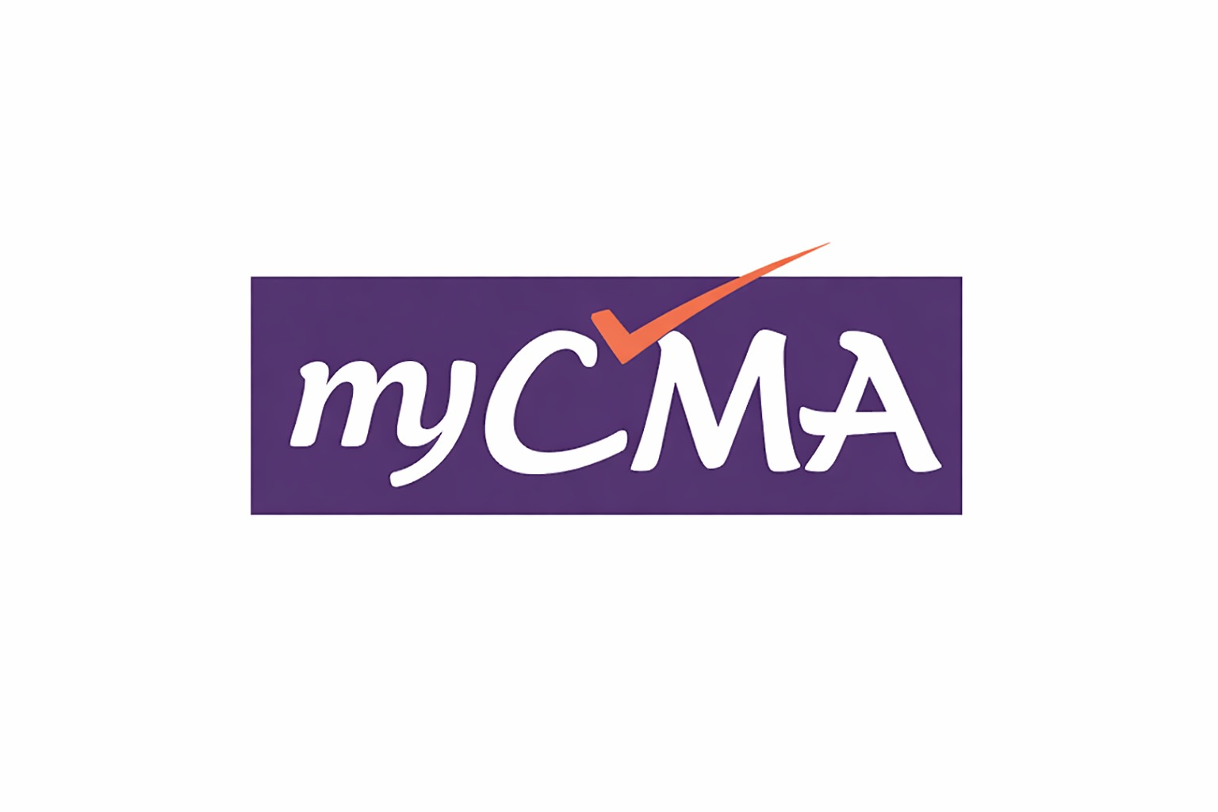
Negotiable Instruments
Act, 1881
CMA Foundation | Paper 1 – Fundamentals of Business Laws
Lecture PPT • Exam Oriented • MCQ Practice
Prepared by myCMA | www.mycma.in

Slide 2
Learning Objectives
1
Understand the meaning and characteristics of Negotiable Instruments
2
Define and distinguish Promissory Note, Bill of Exchange and Cheque
3
Comprehend Crossing of Cheques — types and legal significance
4
Apply provisions of Section 138 on Dishonour of Cheques
5
Solve exam-style MCQs on the Negotiable Instruments Act, 1881
Negotiable Instruments Act, 1881 | CMA Foundation – Paper 1

Slide 3
4.1 Negotiable Instruments Act, 1881 – Introduction
A Negotiable Instrument is a document that entitles its holder to receive a certain sum of money and can be transferred from one person to another. [Section 13]
Enacted in 1881, came into force on 1st March 1882 — applicable to whole of India.
Defined in Section 13: 'Promissory Note, Bill of Exchange or Cheque payable to order or bearer.'
Section 14 defines negotiation: Transfer of an instrument with the right to receive the money.
Instruments transferable by delivery alone (bearer) or by endorsement + delivery (order).
Lost instruments: Presumed to be duly stamped — burden of proof on the party claiming otherwise.
Documents NOT specifically mentioned but transferable by trade custom = Quasi-negotiable instruments.
Not Negotiable Instruments: Share Certificate with Blank Transfer Deed, Deposit Receipt, Mate Receipt.
Negotiable Instruments Act, 1881 | CMA Foundation – Paper 1

Slide 4
4.1 Characteristics of Negotiable Instruments
Negotiable Instruments have certain unique characteristics that distinguish them from ordinary documents of title. These are recognised by law and trade custom.
Free Transferability: Can be freely transferred from one person to another by delivery or endorsement.
Title: The transferee (holder in due course) gets a good title free from defects of the transferor.
Recovery: The holder can sue in his own name without giving notice to the debtor.
Presumptions under Section 118: Every NI was drawn for consideration; made on the date it bears; transferred before maturity; holder is holder in due course.
Unconditional Promise/Order: Contains an unconditional promise (PN) or order (BoE/Cheque) to pay.
Certain Sum of Money: Payment must be in money only — not goods or services.
Grace Period: 3 days of grace are allowed for payment (not for cheques payable on demand).
Negotiable Instruments Act, 1881 | CMA Foundation – Paper 1
Corporation as Party: A corporation can be a party to a NI only if authorized by its Articles of Association.

Slide 5
4.2 Promissory Note [Section 4]
Section 4: A Promissory Note is 'an instrument in writing (not being a bank-note or a currency-note) containing an unconditional undertaking, signed by the maker, to pay a certain sum of money only to, or to the order of, a certain person, or to the bearer of the instrument.'
Parties: 2 parties — Maker (Promisor, who signs and promises to pay) and Payee (to whom payment is to be made).
Nature: Contains an UNCONDITIONAL UNDERTAKING (promise) — not an order.
Acceptance: NOT required (no drawee). There is no drawer either.
Currency Note / Bank Note: NOT a promissory note though it has all features of one (by statute).
Stamp: Must be stamped as per the Indian Stamp Act.
Grace Period: 3 days of grace allowed if payable after specified time (not on demand).
Notice of Dishonour: NOT required in case of dishonour of a promissory note.
Negotiable Instruments Act, 1881 | CMA Foundation – Paper 1
Section 9: PN — Date not required by law but presumed to bear date it was drawn.
Liability: The maker is primarily and unconditionally liable to pay.

Slide 6
4.2 Bill of Exchange [Section 5]
Section 5: A Bill of Exchange is 'an instrument in writing containing an unconditional order, signed by the maker, directing a certain person to pay a certain sum of money only to, or to the order of, a certain person or to the bearer of the instrument.'
Parties: 3 parties — Drawer (maker), Drawee (person directed to pay), Payee (recipient of payment).
Note: In some cases, Drawer and Payee can be the same person.
Nature: Contains an UNCONDITIONAL ORDER — not a promise.
Acceptance: REQUIRED if payable after sight (for the bill to become operative).
Cannot be payable to Bearer on Demand: A bill cannot be made payable to bearer on demand (unlike cheque).
Notice of Dishonour: Required to be given to the drawer and endorsers.
Grace Period: 3 days of grace allowed if payable after specified time.
Negotiable Instruments Act, 1881 | CMA Foundation – Paper 1
Acceptor for Honour (Sec. 116): May accept and pay a bill without previous protest.
Ambiguous Instrument: If an instrument can be either a PN or BoE, it is an ambiguous instrument — holder can treat it as either.
Holder in Due Course: A person who gets possession before maturity, for consideration, without notice of defect in title.

Slide 7
4.2 Cheque [Section 6]
Section 6: A Cheque is 'a bill of exchange drawn on a specified banker and not expressed to be payable otherwise than on demand.' A cheque is a SPECIES of Bill of Exchange.
Parties: 3 parties — Drawer (account holder who draws), Drawee (specified BANK), Payee (person in whose favour drawn).
A cheque is a BILL OF EXCHANGE (not a promissory note) — drawn on specified banker — payable on demand.
Acceptance: NOT required. Bank is bound to pay on presentation (if funds exist).
Grace Period: NOT allowed. Payable immediately on presentation (on demand).
Notice of Dishonour: NOT required for dishonour of cheque (Section 138 proceedings apply instead).
Validity Period: A cheque must be presented within 3 months from date of issue.
Electronic Cheque (Sec. 6 Explanation 1(a)): A cheque in electronic form — defined under Section 6.
Negotiable Instruments Act, 1881 | CMA Foundation – Paper 1
Truncated Cheque (Explanation 2): Image-based cheque used in clearing process.
Bank Refusal: Bank may refuse payment if — (a) Insufficient funds, (b) Signature mismatch, (c) Stop payment instruction received.
Bearer Cheque: Negotiated by mere delivery. Order Cheque: Requires endorsement + delivery.

Slide 8
4.3 Comparison: Promissory Note vs Bill of Exchange vs Cheque
Feature
Promissory Note
Bill of Exchange
Cheque
Section
Section 4
Section 5
Section 6
Nature
Unconditional Promise
Unconditional Order
Unconditional Order
Parties
2 (Maker & Payee)
3 (Drawer, Drawee, Payee)
3 (Drawer, Bank, Payee)
Drawee
No drawee
Any person
Specified Bank only
Acceptance
Not required
Required (after sight)
Not required
Payable
On demand or future
On demand or future
Always on demand
Grace Period
3 days (not on demand)
3 days (not on demand)
NO grace period
Notice of Dishonour
Not required
Required
Not required (Sec.138)
Payable to Bearer
Can be made payable to bearer
Cannot be payable to bearer on demand
Can be made bearer
Stamp
Required
Required
No stamp required
Currency Note
Not a PN (by statute)
—
—
Negotiable Instruments Act, 1881 | CMA Foundation – Paper 1

Slide 9
4.4 Crossing of Cheques – Meaning and Purpose
Crossing = Drawing two parallel transverse lines on the face of the cheque, with or without words. Crossing restricts the mode of payment — it CANNOT be paid across the counter (cash).
Purpose of Crossing: Protects the drawer from fraud. The crossed cheque can ONLY be paid through a bank account (not in cash).
Crossing affects the MODE of payment but does NOT affect the NEGOTIABILITY of the cheque.
Who can cross? Maker/Drawer of cheque, the Holder, or the Banker.
Section 123: General Crossing — two parallel transverse lines with or without 'and company' or '& Co.' or 'Not Negotiable'.
Section 124: Special Crossing — name of a specific banker written between two parallel lines (or without lines).
Open Cheque: NOT crossed — payable across the counter in cash. Also called 'uncrossed cheque'.
Crossed Cheque: Cannot be paid over the counter — must be deposited in a bank account for collection.
Negotiable Instruments Act, 1881 | CMA Foundation – Paper 1
'Not Negotiable' Crossing: The cheque can still be transferred but the transferee does NOT get better title than the transferor.

Slide 10
4.4 Types of Crossing
1. General Crossing [Section 123]
Two parallel transverse lines drawn across the face of the cheque.
May contain words: '& Co.', 'Not Negotiable', 'Account Payee', or nothing.
Effect: Must be paid only through a bank — NOT across the counter.
2. Special Crossing [Section 124]
A generally crossed cheque can be paid to ANY banker for collection.
Name of a specific banker is written between two parallel lines (or even without lines).
Effect: Can ONLY be paid to the specified bank — not any other banker.
The specific banker acts as the collecting bank.
3. 'Account Payee' / 'Not Negotiable' Crossing — Additional Restrictions
'Account Payee': Proceeds can be credited ONLY to the payee's account. NOT transferable. | 'Not Negotiable': Cheque is transferable but transferee does NOT get better title than transferor.
If 'Not Negotiable' is also added: Restricts further rights of the holder.
Negotiable Instruments Act, 1881 | CMA Foundation – Paper 1

Slide 11
4.5 Dishonour of Cheques – Section 138
Section 138 of the NI Act, 1881 (inserted by Banking, Public Financial Institutions and Negotiable Instruments Laws Amendment Act, 1988): Dishonour of cheque for insufficiency of funds is a CRIMINAL OFFENCE.
Offence: When a cheque is returned by the bank as unpaid due to (a) insufficient funds in the account, or (b) the amount exceeds the limit agreed with the bank.
Section 138 provides for IMPRISONMENT up to 2 years OR FINE up to TWICE the cheque amount OR BOTH.
The offence u/s 138 has FOUR ingredients (not three or five): (1) Drawing of cheque, (2) Return unpaid, (3) Issue of notice, (4) Failure to pay.
Notice: The payee/holder must give written notice to the drawer within 30 days of receiving memo of dishonour from the bank.
Time to Pay: The drawer gets 15 days from receipt of notice to make payment.
Filing of Complaint: If drawer fails to pay within 15 days, complaint must be filed within 1 month of expiry of the 15-day period.
Court: Only the Metropolitan Magistrate or Judicial Magistrate of First Class can try such cases.
Negotiable Instruments Act, 1881 | CMA Foundation – Paper 1
The bank gives notice to the DRAWER upon dishonour of cheque.

Slide 12
4.5 Section 138 – Procedure for Filing Complaint
1
Cheque Issued
2
Cheque Dishonoured
3
Notice by Payee
Drawer issues a cheque for payment of debt or liability. Cheque must be for a legally enforceable debt.
Bank returns the cheque unpaid due to insufficient funds or exceeds arrangement. Bank issues dishonour memo.
Payee must send written DEMAND NOTICE to drawer within 30 days of receiving the dishonour memo from bank.
4
15-Day Window
5
Complaint Filed
6
Trial & Punishment
Drawer gets 15 days from receipt of notice to make payment. This is the LAST chance to avoid criminal liability.
If drawer fails to pay within 15 days, payee must file complaint before Magistrate within 1 month of expiry of 15-day notice period.
Tried by Metropolitan Magistrate / Judicial Magistrate 1st Class. Punishment: Imprisonment up to 2 years OR Fine up to 2× cheque amount OR Both.
Key Time Limits: Notice within 30 days of dishonour memo → Drawer has 15 days to pay → Complaint within 1 month of expiry of 15-day period | Punishment: 2 yrs imprisonment OR 2× cheque amount fine OR both
Negotiable Instruments Act, 1881 | CMA Foundation – Paper 1

Slide 13
Holder and Holder in Due Course
Holder [Section 8]
Holder in Due Course [Section 9]
A person entitled to possession of the NI and to receive or recover the amount due on it.
A person who possesses a NI and becomes the holder: (1) for consideration, (2) before maturity, (3) without notice of defect in title of transferor.
Includes payee, endorsee or bearer.
Gets BETTER title than the transferor — free from defects.
A holder does NOT necessarily have a good title.
ALL three conditions must be satisfied simultaneously.
Rights: Can sue in own name; can negotiate the instrument.
Minor: Cannot be a holder in due course (no contractual capacity).
Must have legal possession of the instrument.
If minor draws, endorses, delivers NI — ALL parties except the minor are bound.
Negotiable Instruments Act, 1881 | CMA Foundation – Paper 1

Slide 14
Endorsement, Negotiation and Important Provisions
Endorsement = Signing on the back of an instrument for the purpose of transferring it to another person. It transfers both the instrument and the rights therein.
Bearer Instrument: Negotiated by mere DELIVERY (no endorsement needed).
Order Instrument: Negotiated by ENDORSEMENT + DELIVERY.
Inchoate Instrument (Section 20): An instrument incomplete in one way or another — called an inchoate instrument.
Ambiguous Instrument: Can be construed as either PN or BoE — the holder can treat it as either.
Amount in words vs. figures: When they differ, the AMOUNT IN WORDS shall prevail [Section 18].
Maturity: A bill payable 'at sight' or 'on presentation' is deemed payable ON DEMAND [Section 21].
Presumptions u/s 118: (a) for consideration (b) on date it bears (c) before maturity (d) in order of endorsements (e) holder is HiDC (f) lost instrument was duly stamped.
Negotiable Instruments Act, 1881 | CMA Foundation – Paper 1
Section 5 deals with Bills of Exchange. Section 6 deals with Cheques. Section 13 defines NI.
Quasi-NI: Documents not specifically defined as NI but transferred as per trade custom — Railway Receipt, Government Promissory Note, etc.

Slide 15
MCQ Practice – Question 1
Q1: A Promissory Note contains a/an
A. Unconditional order
✓ B. Unconditional undertaking (promise)
C. Conditional order
D. Conditional undertaking
Answer: B | A Promissory Note contains an UNCONDITIONAL UNDERTAKING (promise) by the maker to pay. A Bill of Exchange contains an unconditional ORDER. [Section 4 vs Section 5]
Negotiable Instruments Act, 1881 | CMA Foundation – Paper 1

Slide 16
MCQ Practice – Question 2
Q2: The Negotiable Instruments Act was enacted in the year
A. 1880
✓ B. 1881
C. 1882
D. 1883
Answer: B | The Negotiable Instruments Act was enacted in 1881 and came into force on 1st March 1882. It applies to the whole of India.
Negotiable Instruments Act, 1881 | CMA Foundation – Paper 1

Slide 17
MCQ Practice – Question 3
Q3: Upon dishonour of a cheque, the payee can initiate legal action under which Section of the NI Act?
A. Section 137
✓ B. Section 138
C. Section 175
D. Section 180
Answer: B | Section 138 of the NI Act deals with dishonour of cheques for insufficiency of funds. It provides for imprisonment up to 2 years and/or fine up to twice the cheque amount.
Negotiable Instruments Act, 1881 | CMA Foundation – Paper 1

Slide 18
MCQ Practice – Question 4
Q4: Where a cheque is crossed GENERALLY, the banker on whom it is drawn
A. Shall pay it to any person
✓ B. Shall not pay it otherwise than to a banker
C. Shall not pay it to a banker
D. Shall pay it only to the holder
Answer: B | Section 126: When a cheque is crossed generally, the banker shall NOT pay it otherwise than to a banker. It must be collected through a bank account — not paid in cash.
Negotiable Instruments Act, 1881 | CMA Foundation – Paper 1

Slide 19
MCQ Practice – Question 5
Q5: A Holder in Due Course is a person who becomes the holder of an instrument
A. Before maturity only
B. For consideration only
C. Without notice of defect in title only
✓ D. All of the above (before maturity + consideration + no notice of defect)
Answer: D | Section 9: A Holder in Due Course must satisfy ALL THREE conditions: (1) Obtains the NI for consideration, (2) before maturity, and (3) without notice of any defect in title of the transferor.
Negotiable Instruments Act, 1881 | CMA Foundation – Paper 1

Slide 20
MCQ Practice – Question 6
Q6: In case of cheque, which of the following statements is CORRECT?
A. Acceptance by the drawee is required
B. Grace period of 3 days is allowed
✓ C. Acceptance by the drawee is NOT required
D. It contains an unconditional promise
Answer: C | A cheque does NOT require acceptance by the bank (drawee). A cheque is payable on demand — no grace period. It contains an unconditional ORDER (not a promise). The bank is bound to pay if funds exist.
Negotiable Instruments Act, 1881 | CMA Foundation – Paper 1

Slide 21
Exam Tips & Quick Revision
PN vs BoE vs Cheque
PN = Promise (2 parties, no drawee, no acceptance, no stamp on cheque). BoE = Order (3 parties, acceptance required for 'after sight'). Cheque = BoE on specified bank (on demand, no acceptance, no grace period, Sec 138 on dishonour).
Parties
Cheque: Drawer = Account holder, Drawee = Bank, Payee = beneficiary. BoE: Drawer + Drawee + Payee (3 parties). PN: Maker + Payee (2 parties).
Crossing of Cheques
General: Two parallel lines (paid through any bank). Special: Specific bank named (paid only through that bank). 'Not Negotiable': Transferable but no better title. 'Account Payee': Only payee's account. Crossing affects MODE of payment, not negotiability.
Section 138 – Key Dates
Notice: within 30 days of dishonour memo. Drawer's time to pay: 15 days from notice. Complaint: within 1 month after 15-day period expires. Punishment: 2 yrs imprisonment OR 2× cheque amount fine OR Both.
Common MCQ Traps
PN = unconditional promise (NOT order). Cheque = BoE (not PN). Acceptance NOT required for cheque. Currency note ≠ PN (by statute). Amount in words > figures (words prevail). Holder in Due Course: ALL 3 conditions mandatory. Lost NI: Presumed to be duly stamped.
Negotiable Instruments Act, 1881 | CMA Foundation – Paper 1

Slide 22
Thank You!
Best of luck for your CMA Foundation Exam!
For more resources, visit www.mycma.in
Negotiable Instruments Act, 1881 | CMA Foundation Paper 1 | myCMA

